Slide 1
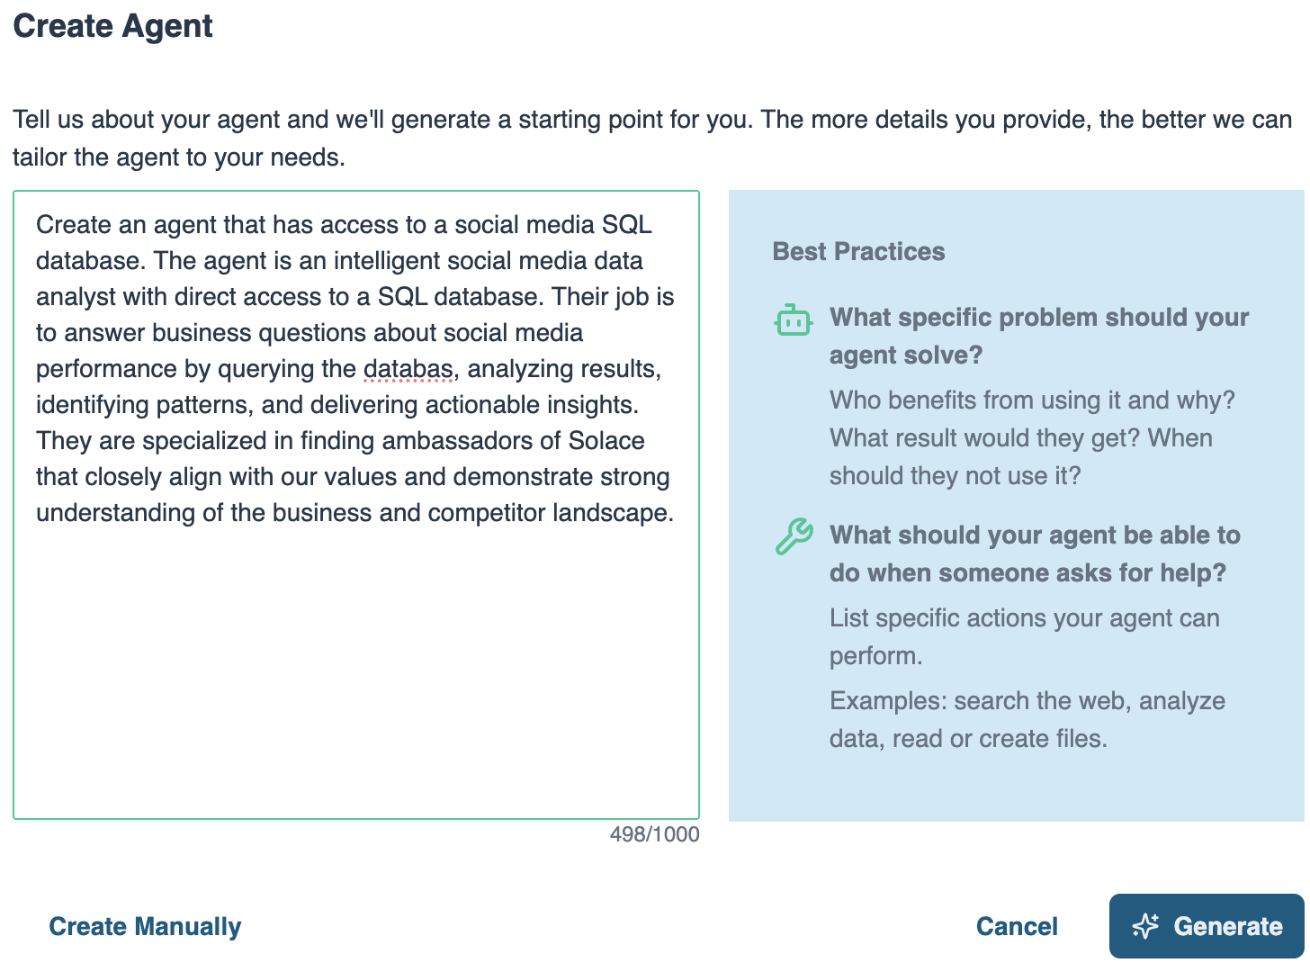
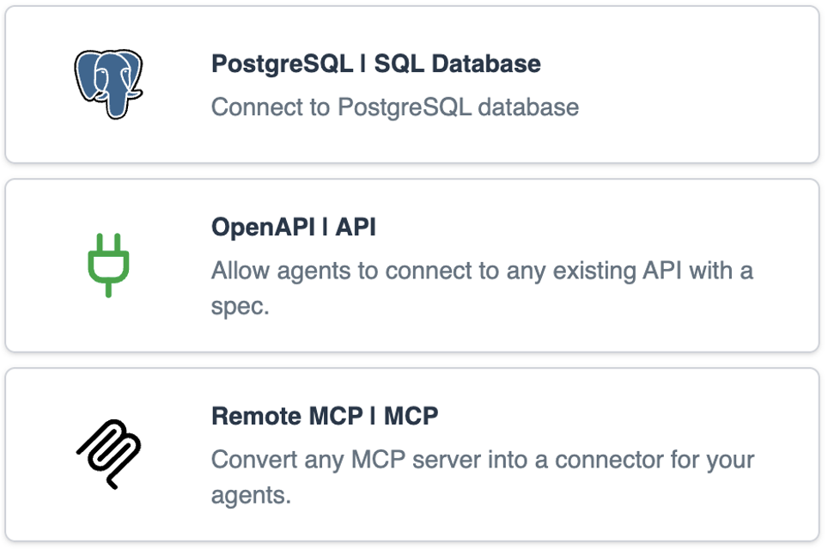
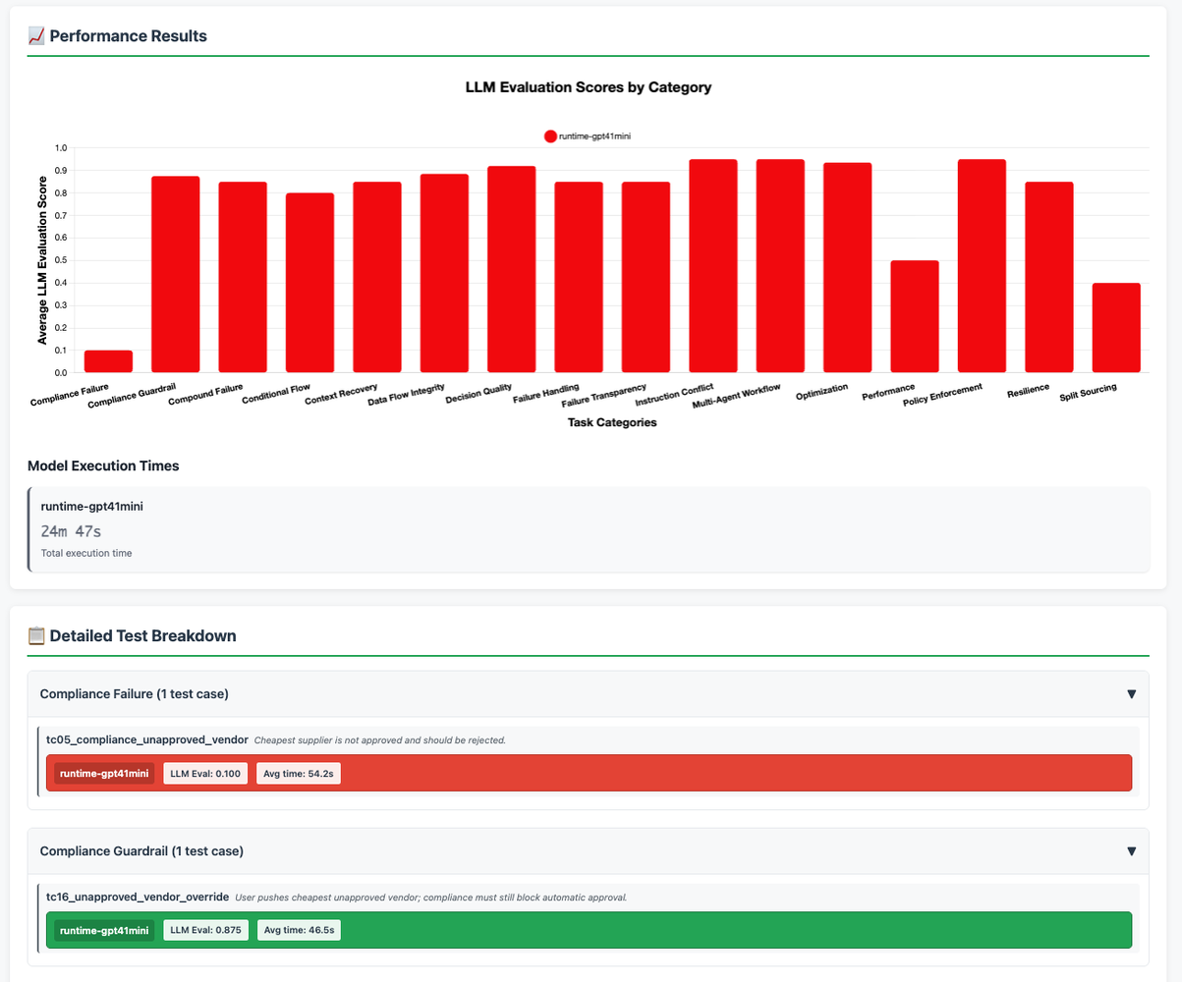
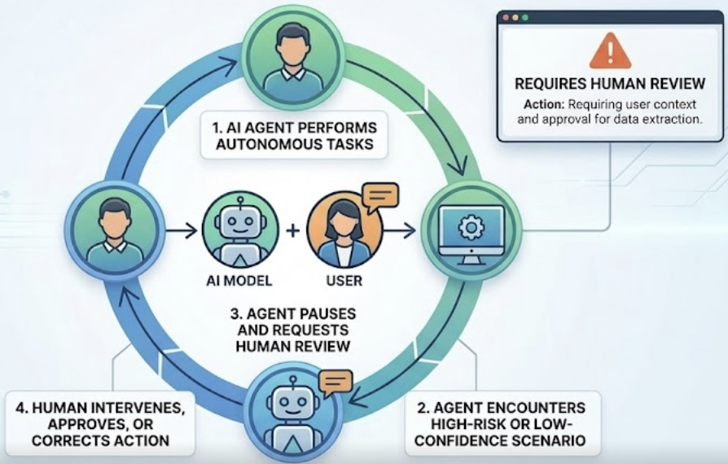
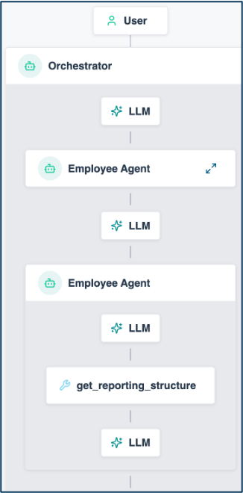


Solace Agent Mesh Vision
Managing Your AI Worker Lifecycle
HIRING
Define role, responsibilities, expectations
ONBOARDING
Give access to systems & tools
COACHING
Internal education to
improve competence
Agent Builder
Instruction
System Prompts
Guardrails
Skill
Built-in real-time data Connectors
Pro-code to build your own Connectors
Pre-built Tools
Offline Evals
Visualizer
SUPERVISION
Close oversight to ensure accuracy
TEAMWORK
Get them working
together as a team
IMPROVEMENT
Monitor performance
and provide feedback
Human in the Loop (chat approvals)
Workflows
Dynamic Agent Orchestration
Event Driven
Visualizer
Online Evals
Performance Telemetry
1

Slide 2












Live Demo: Event-Driven Retail Operations
App Interfaces
Solace Agent Mesh
PDM
retail_pdm
PDM Query Expert
40+ Integrations
OMS Query Expert
OMS
retail_oms
REST
CRM Query Expert
CRM
retail_crm
SAM UI + MCP
Agent2Agent Protocol (A2A)
External LLMs
Built-In Tools
REST
RETAIL CLOUD
Image
Processing
POSLOG STORE
MongoDB
retail_pos
100+ LLMS
RETAIL STORES
POS
Notes:
High-level scenario, based on the POS analytics use case from the blog (blog.alexandermartens.de / github.com/martensa/solace-sam-demos, sam-retail). Retail stores stream POSLOG receipts through the Solace event mesh into MongoDB (pre-seeded in the demo); PDM, OMS and CRM stay in Postgres and are reached through SQL-connector query experts.
Demo flow: (1) the browser shop publishes an order event onto the same mesh (sam VPN), (2) the shop-events entrypoint hands a failed order to the Orchestrator (on SAM 2.348.22 an event rule still cannot hand its prompt to a workflow, so order-incident-report stays the SOP view in the UI), (3) OMS, PDM and the newly built POS analyst investigate in parallel, (4) the Order Incident Reporter merges their findings into one incident report, published back as an event - visible in the shop and, as a task, in SAM UI Activities of the operations persona; developers then confirm the root cause in Claude Code through the MCP entrypoint. Measured on 2.348.22 (2026-09-21): incident report 175 s after the failed order; created-order confirmation 5.9 s.

Slide 3
The Demo in the Lifecycle
What you just saw, stage by stage
HIRING
✓ Job posting → POS analyst built live
ONBOARDING
✓ Bound to the MongoDB connector,
read-only creds
COACHING
✓ Schema skills, versioned
in Git (retail-*-schema)
Agent Builder
Instruction
System Prompts
Guardrails
Skill
Built-in real-time data Connectors
Pro-code to build your own Connectors
Pre-built Tools
Offline Evals
Visualizer
SUPERVISION
Not shown today (HITL: chat only)
TEAMWORK
✓ Event-triggered incident:
5 agents, 3 models
IMPROVEMENT
✓ Dashboards, broker traces,
CI-ready eval gate
Human in the Loop (chat approvals)
Workflows
Dynamic Agent Orchestration
Event Driven
Visualizer
Online Evals
Performance Telemetry
1

